Slide 1

BLOOD BANK MANAGEMENT SYSTEM
Presented by:
VISHALINI M
NIVETHA S
MAHALAKSHMI M
Domain:
HEALTH CARE
College:
J.J COLLEGE OF ENGINEERING AND TECHNOLOGY

Slide 2
INTRODUCTION & OBJECTIVE
INTRODUCTION:
Manual blood management is time-consuming and error-prone. Difficulty in tracking donors and blood stock. Delays in providing blood during emergencies. A Blood Bank Management System automates these processes for faster and more efficient service.
Donor Management Register and manage donor information. Blood Inventory Monitor blood stock by blood group. Blood Requests Process blood requests quickly and efficiently.
Donation History
Track donor eligibility and donation records.
OBJECTIVE:
Develop a Python-based Blood Bank Management System that efficiently manages donor records, blood inventory, and blood requests while ensuring fast, accurate, and reliable blood distribution.

Slide 3
PROBLEM STATEMENT
Stock Tracking
It does not Ensures accurate blood availability.
CURRENT CHALLENGES IN BLOOD MANAGEMENT:
Blood donor and inventory records are often managed manually. Difficulty in tracking real-time blood stock availability. Delays in finding compatible blood during emergencies. Lack of proper donor eligibility and donation history management. Manual processes increase errors, paperwork, and response time.
Emergency Response
No Quick identification and allocation of required blood.
Manual Errors
No Automated records improve accuracy and efficiency.

Slide 4
PROPOSED SOLUTION
SOLUTION:
Develop a Python-based Blood Bank Management System that automates donor registration, blood inventory management, and blood request processing. The system provides real-time blood availability, maintains donation history, and ensures quick and reliable blood distribution during emergencies.
KEY FEATURES:
Donor Registration – Store and manage donor details. Blood Inventory – Track blood stock by blood group. Blood Availability Check – View available blood units instantly. Donation History – Maintain donor records and eligibility. Blood Request Management – Process emergency blood requests efficiently
HOW IT’S WORK:
Donor registers with personal and blood group details. Blood donation updates the inventory. A patient submits a blood request. The system checks blood availability. If available, blood is issued and stock is updated. Admin can monitor donors, blood stock, and reports.

Slide 5
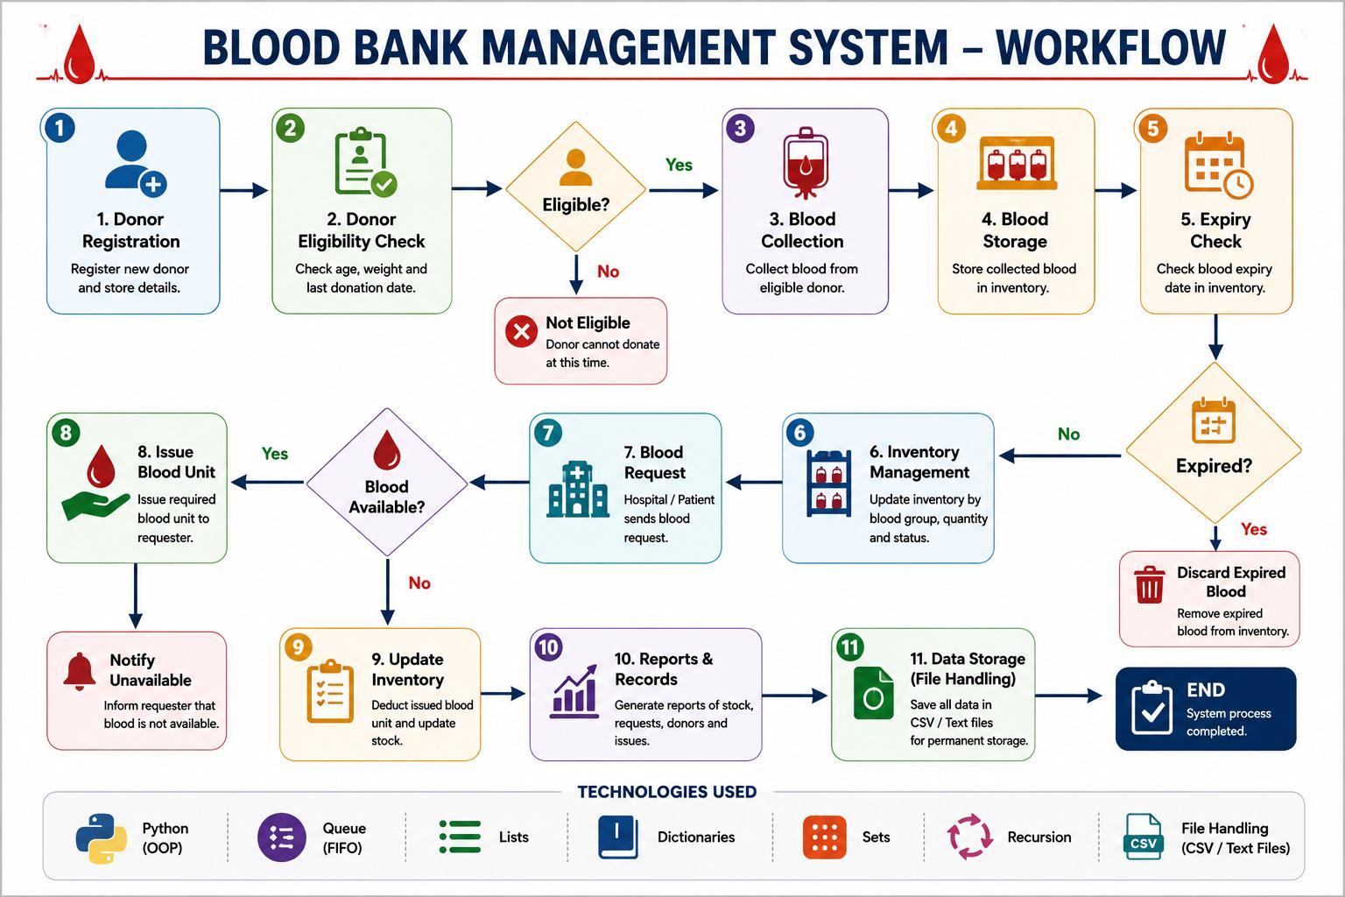
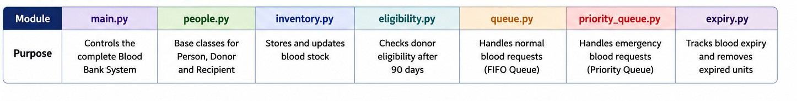
SYSTEM ARCHITECTURE

Slide 6












TECHNICAL METHODOLOGY
Blood Bank Management System — Pipeline-Driven, Rule-Based Automation
DATA DESIGN
WHY IT'S INNOVATIVE
MODULE EXECUTION FLOW
Donor & recipient records — dictionary-based modeling
Blood inventory — nested dict by blood group
Request handling — FIFO queue for fairness
Donation history — list-based tracking
Persistence — CSV/text file storage (no DB)
Rule-Based Automation
Sequential pipeline architecture
1. Donor Registration
Eligibility checks run entirely on recursive logic — no manual overrides, reducing human error in donor screening.
2. Eligibility Check (Recursive)
FIFO Fairness Algorithm
3. Blood Collection
A deliberate design choice, not just a data structure: guarantees ethical, first-come-first-served allocation of scarce blood units.
4. Blood Testing
CORE TECHNOLOGY STACK
Python (OOP) — modular Donor/BloodBank classes
Queue (FIFO) — fair request handling
Priority Queue – to handle emeergency
File Handling — CSV/text persistence
Lists, Dicts, Sets — fast lookups, no duplicates
Recursion — efficient eligibility search
5. Blood Storage (Indexed)
Zero-Dependency Architecture
6. Inventory Management
No external database required — CSV/file-based storage keeps the system portable and deployable in low-resource clinics.
7.Issue & Report Generation

Slide 7
FEATURES & FUTURE SCOPE
FEATURES:
Donor registration & recursive search 90-day eligibility check Blood inventory tracking Donation history & request management Admin login with alerts for low stock
FUTURE SCOPE:
Mobile/web app with database integration Automated donor notifications Analytics dashboard & hospital API integration Role-based access & donor rewards system

Slide 8
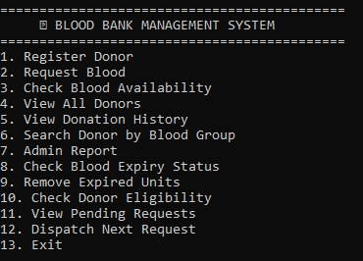
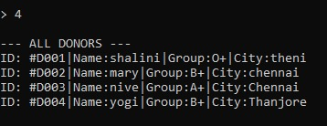
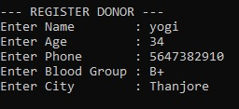
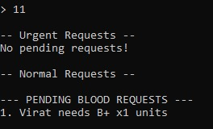
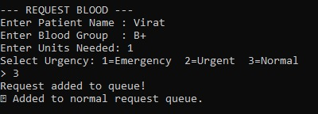
SAMPLE OUTPUT

Slide 9
CONCLUSION
The Blood Bank Management System simplifies blood donation and blood inventory management. It improves accuracy, saves time, and reduces manual errors. It helps hospitals and patients get blood quickly during emergencies. Overall, it makes blood bank operations more efficient, safe, and reliable.
THANK YOU !

